Slide 1
Weekly report: Foundations
Week number: 07
Date: 04/14/2025
Supervisor: Prof. Dr.-Ing. Torsten Faber
Group members : Jehad Albaali- Amgad Gerges - Reda Deif
presented by : Amgad Gerges

Slide 2
List of contents
Reverification with detailed drawing
Concrete cover
Time Schedule Planning
Next tasks
Group members: Jehad Albaali- Amgad Gerges - Reda Deif
Foundations team/ Optimus Syria

Slide 3
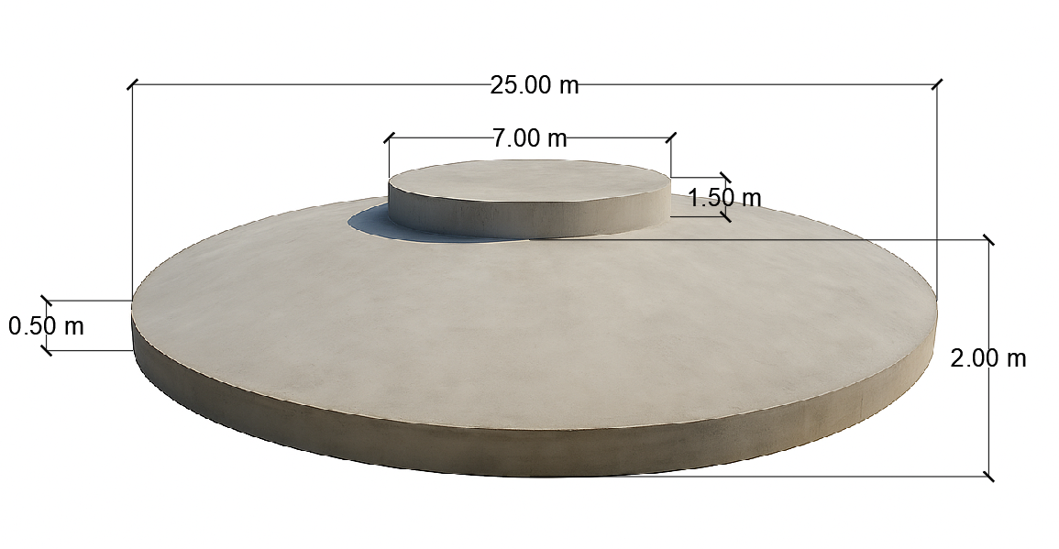
Concrete Dimensions
Diameter of Base Plate (BP) = 25 m
Diameter of Pedestal = 7 m
Height Pedestal = 1.5 m
Height of Middle slab = 2 m
Height of Frustum (HF) = 1.5 m
Height of Edge slab (HE) = 0.5 m
Group members: Jehad Albaali- Amgad Gerges - Reda Deif
Foundations team/ Optimus Syria

Slide 4
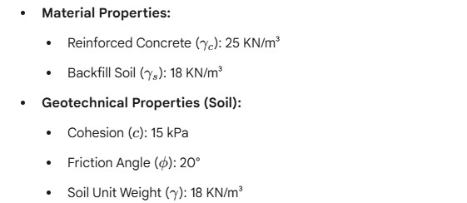
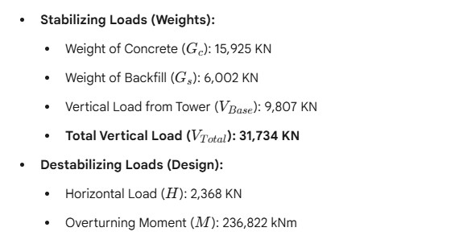
Input data
Group members: Jehad Albaali- Amgad Gerges - Reda Deif
Foundations team/ Optimus Syria

Slide 5
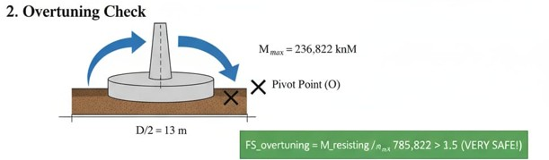
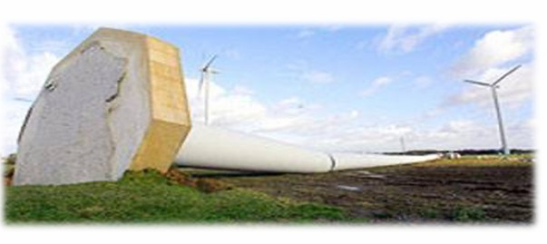

*Reverification with detailed drawing
-Overturning Check
$$source:\text{Foundation} \text{WS} \text{2025}\text{/}\text{26 }\text{Prof}\text{. }\text{Dr}\text{.}\text{−}\text{Ing}\text{. }\text{Torsten} \text{Faber}$$
Group members: Jehad Albaali- Amgad Gerges - Reda Deif
Foundations team/ Optimus Syria

Slide 6
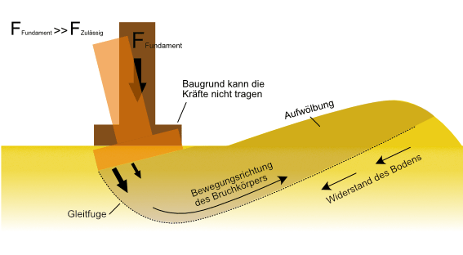
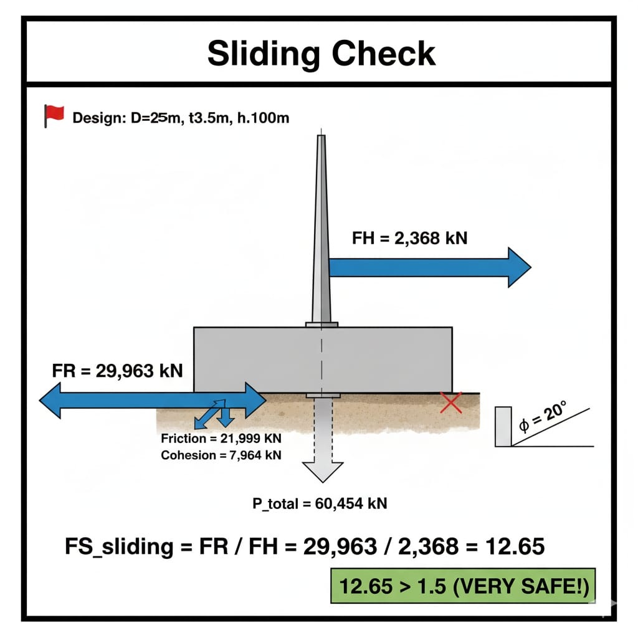

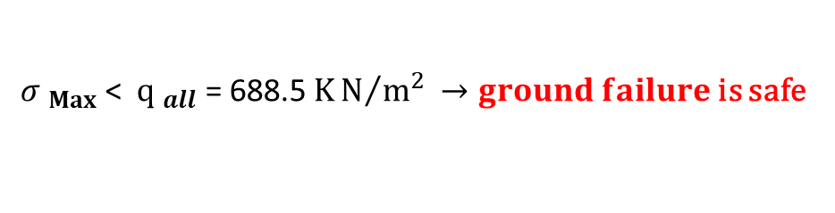
*Reverification with detailed drawing
-Ground Failure and Sliding Check
${ σ }_{Max}$ < ${ q }_{all}$ = 688.5 $KN/{m^{2}}$ $→ground failure$ is safe
$source:\text{Bautabellen} \text{f}$ür Ingenieure
Group members: Jehad Albaali- Amgad Gerges - Reda Deif
Foundations team/ Optimus Syria

Slide 7
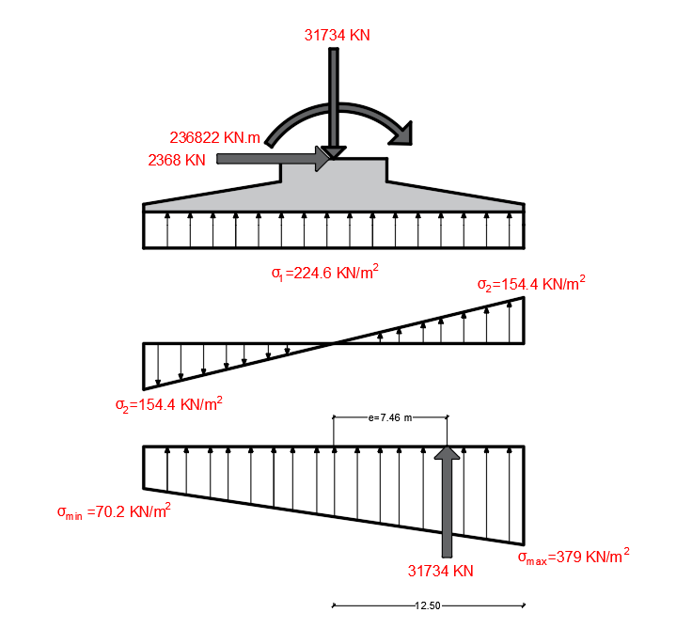
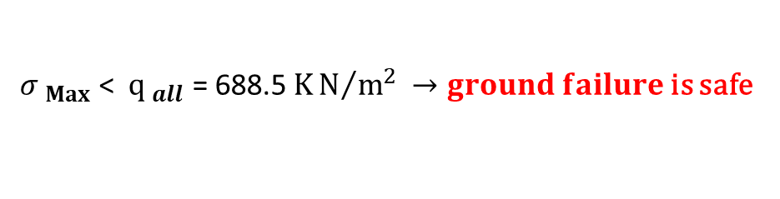
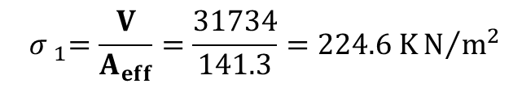
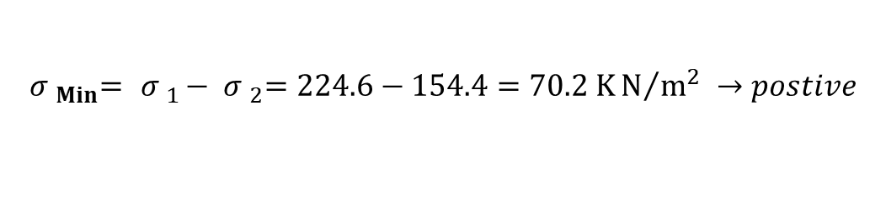
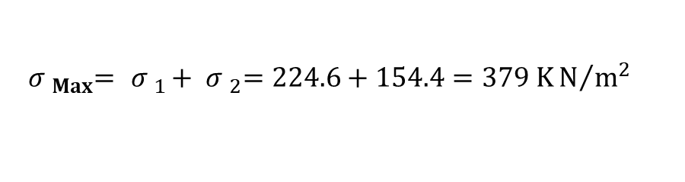
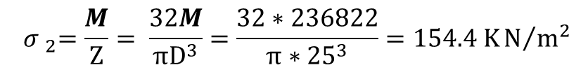
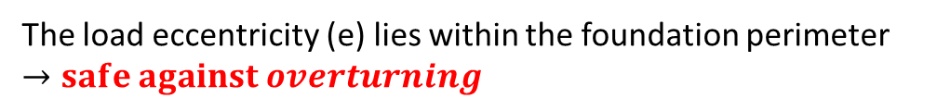
Reverification with detailed drawing
-Calculation
$${ σ }_{1}=\frac{V}{A_{eff}}=\frac{31734}{141.3}=224.6 KN/{m^{2}}$$
$${ σ }_{2}=\frac{M}{Z}= \frac{32M}{πD^{3}}=\frac{32∗236822}{π∗{25}^{3}}=154.4 KN/{m^{2}}$$
$${ σ }_{Max}= { σ }_{1}+ { σ }_{2}=224.6+154.4=379 KN/{m^{2}}$$
${ σ }_{Max}$ < ${ q }_{all}$ = 688.5 $KN/{m^{2}}$ $→ground failure$ is safe
$${ σ }_{Min}= { σ }_{1}− { σ }_{2}=224.6−154.4=70.2 KN/{m^{2}} →postive$$
${ σ }_{Min}$ $→postive→safe against uplift$
The load eccentricity (e) lies within the foundation perimeter $→safe against overturning$
Group members: Jehad Albaali- Amgad Gerges - Reda Deif
Foundations team/ Optimus Syria

Slide 8
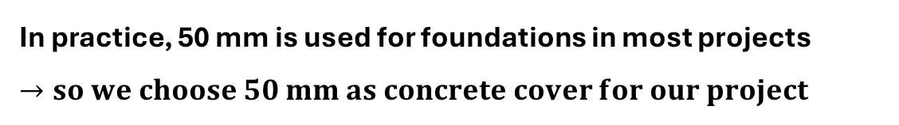
Concrete Cover
The concrete cover is the distance between the surface of the reinforcement closest to the nearest concrete surface (including links and stirrups and surface reinforcement where relevant) and the nearest concrete surface.
Factors affecting concrete cover
• The design life length of the structure
• The quality of the concrete
• The exposure to chlorides
• The variation of wet- and dry state
• The exposure to chemical aggressive environment
In practice, 50 mm is used for foundations in most projects $→so we choose 50 mm as concrete cover for our project$
Group members: Jehad Albaali- Amgad Gerges - Reda Deif
Foundations team/ Optimus Syria

Slide 9
Time Schedule Planning
Time Schedule Planning
Week 1-2: Data Collection & Project Kick-off
Week 3-4: Geotechnical Analysis & Conceptual Design
Week 5-7: Detailed Design & Verification
Week 8-9: Structural Design (Rebar & Shear)
Week 10-11: Final Drawings & Documentation
Week 12: Final Review & Submission
Group members: Jehad Albaali- Amgad Gerges - Reda Deif
Foundations team/ Optimus Syria

Slide 10
Next Tasks
Design of Raft for bending moment
Design of Raft for shear
Design of Raft for fatigue loading
Group members: Jehad Albaali- Amgad Gerges - Reda Deif
Foundations team/ Optimus Syria

Slide 11

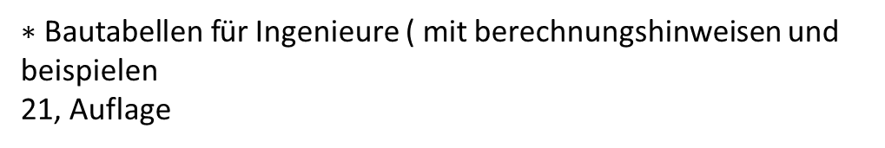
Reference
*https://www.bauprofessor.de/grundbruch
02/11/2025
*Eurocode 7: Geotechnical Design chrome-extension://efaidnbmnnnibpcajpcglclefindmkaj/https://eurocodes.jrc.ec.europa.eu/sites/default/files/2022-06/02 Scarpelli-Design-of-spread-foundations
02/11/2025
*$\text{Foundation} \text{WS} \text{2025}\text{/}\text{26 }\text{Prof}\text{. }\text{Dr}\text{.}\text{−}\text{Ing}\text{. }\text{Torsten} \text{Faber}$
02/11/2025
$∗\text{Bautabellen} \text{f}$ür Ingenieure ( mit berechnungshinweisen und beispielen
21, Auflage
Group members: Jehad Albaali- Amgad Gerges - Reda Deif
Foundations team/ Optimus Syria

